Slide 1
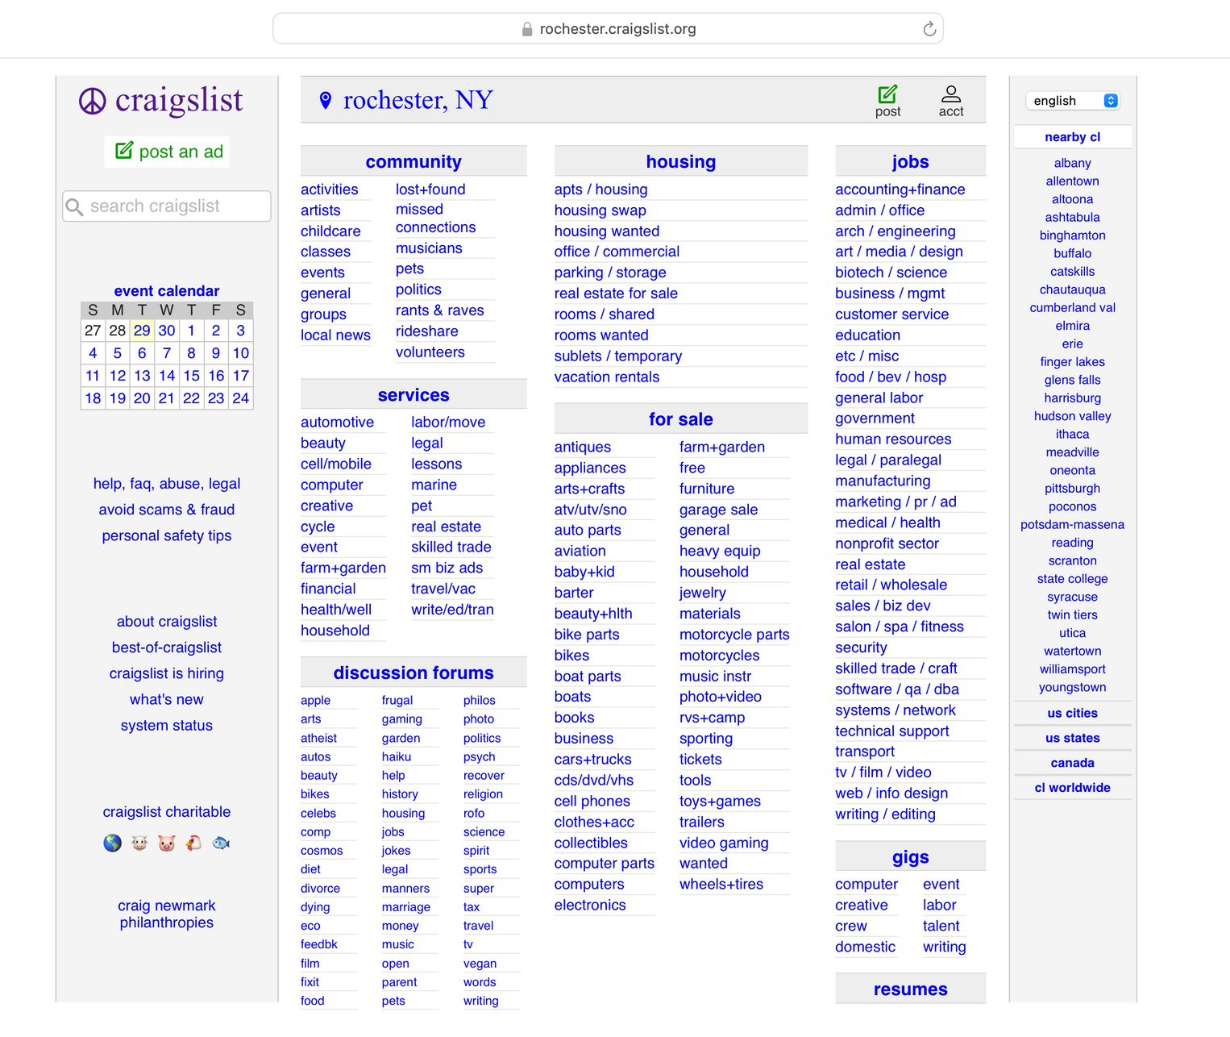
Smart Categorization of Craigslist Ads
Because the
right ad belongs in the right place
Presented by Group 9
4/30/2025

Slide 2
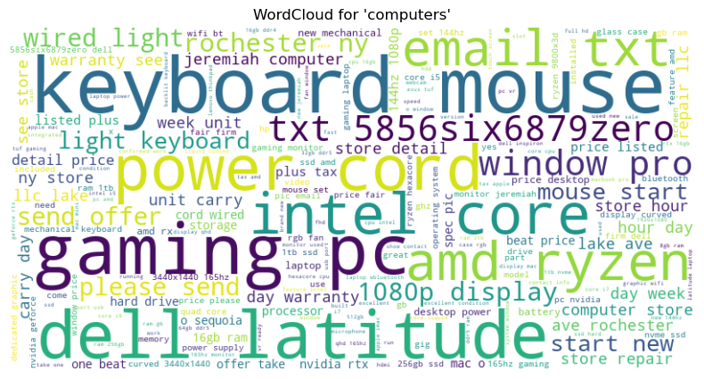
Craigslist allows free-form posting — but that flexibility leads to problems.
30%
Tech-related posts are posted under the wrong category.
Examples: Keyboards listed as “Computers”, Monitors and cables mixed with laptops
Result:Cluttered browsing, poor user experience, more moderation effort.
Notes:
这一页问shan怎么改

Slide 3
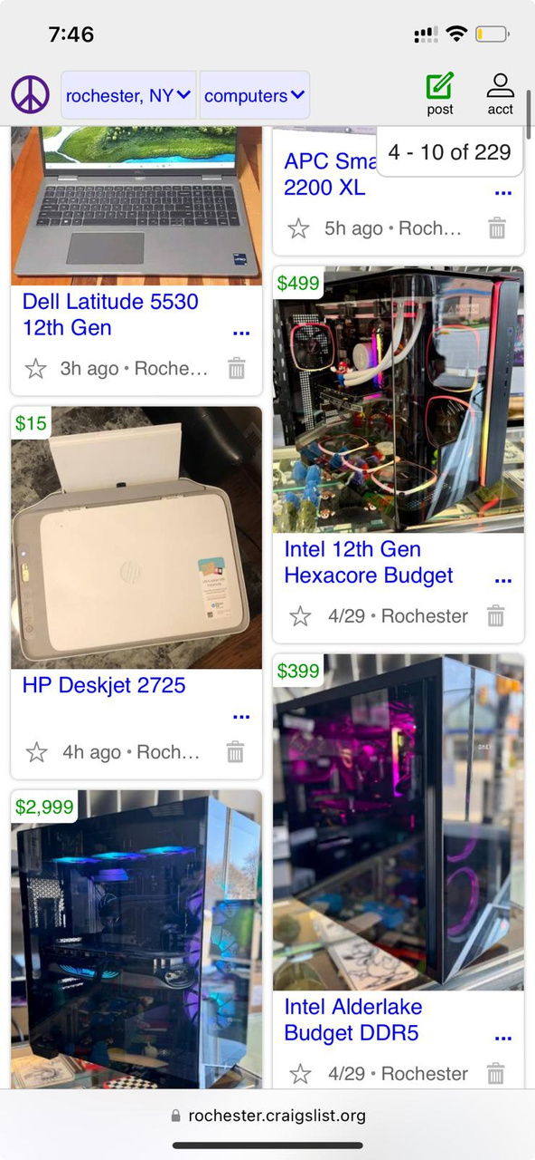
Problem
Thousands of Craigslist ads are misclassified, disrupting search and increasing moderation effort.
Especially prevalent in the Computers and Computer Parts categories.
Listings for accessories often appear alongside full systems leading to frustration and abandoned sessions.
The absence of structured subcategories may reduce user trust in Craigslist's reliability as a buying platform, especially when compared to competitors with structured marketplaces
Notes:
Bullet format

Slide 4



Our Solution:
A model that separates Computers from Computer-parts.
Accurate classification. Cleaner categories. Smarter Craigslist.

Slide 5



The Objective
Build a Smart Classifier
Enhance Search Quality
Support Moderators
Automatically identify whether a listing is a Computer or a Computer Part.
Help users find relevant results faster with cleaner categories.
Reduce manual effort by assisting content moderation through automation.

Slide 6






Process Adopted
01
02
03
04
05
06
Web
Scraping
Data
Cleaning
Text Preprocessing
Feature Engineering
Data
Set-up
Modeling & Evaluation
Scraped ~700 listings from Craigslist (Rochester, NY) using Selenium and BeautifulSoup
Focused on two categories: Computers and Computer Parts
Extracted titles and descriptions for each listing
Combined datasets and added ”human_label" column to identify the original category
Dropped rows with missing or empty text
Stripped whitespace and converted all text to lowercase
Saved a combined dataset for further processing
Used NLTK to tokenize, clean, and remove stop words
Manually selected and consolidated keywords to boost interpretability
Created a unified "text" column for modeling (title + description)
Applied TF-IDF Vectorization (max 3000 features, unigrams only)
Manually selected domain-relevant keywords for a second model
Created sparse matrices for both approaches
Performed an 80/20 Train-Test Split
Ensured reproducibility by setting random_state = 42
Balanced class sizes post-deduplication (302 entries total)
Trained and evaluated 4 models:
Naive Bayes (Multinomial)
Logistic Regression
Support Vector Machine
Random Forest
Evaluated using accuracy, precision, recall, and F1-score
Final Logistic Regression model achieved 87% accuracy and balanced F1-scores across both categories
Notes:
统一左上角的标题位置
对齐一切字符

Slide 7

Data Analysis
Scraping Listings
1
Used BeautifulSoup to parse Craigslist search result pages from Rochester, NY.
Used Selenium to open each listing and extract the title and description fields.
Collected and saved ~700 listings across two categories: Computers and Computer Parts.
2
Extracting Clean Data
Saved raw data into two CSVs: computers.csv and computer_parts.csv.
Concatenated title + description into a unified "text" column.
Removed rows with missing/blank text and saved the cleaned file as combined_data.csv.
Manual Labeling
3
Created a label column based on the original category.
Generated model predictions and compared them with manual labels.
Added a flagged column to identify potential misclassifications for human review.

Slide 8
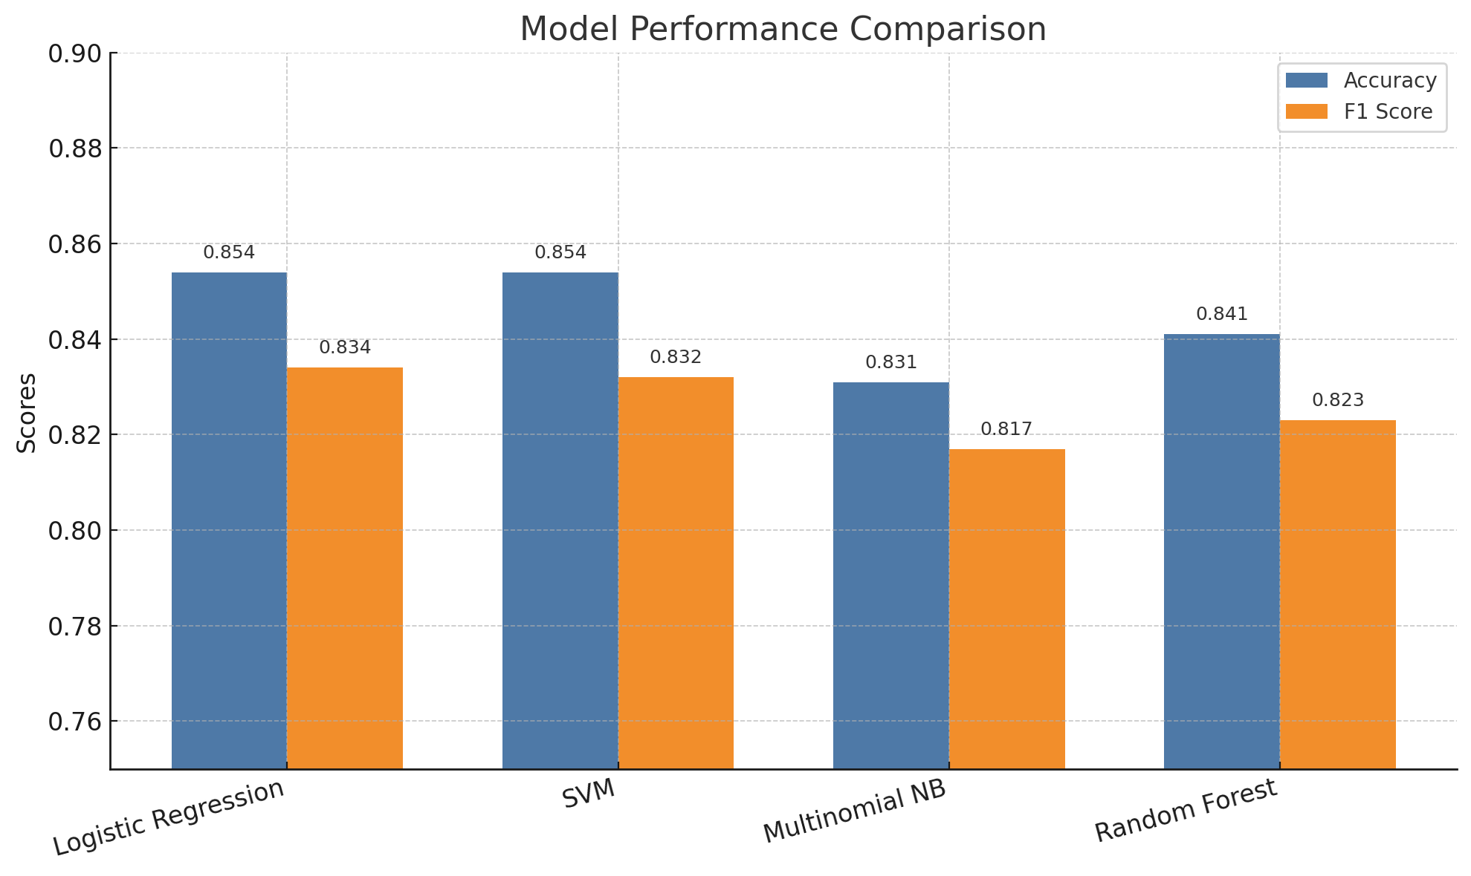
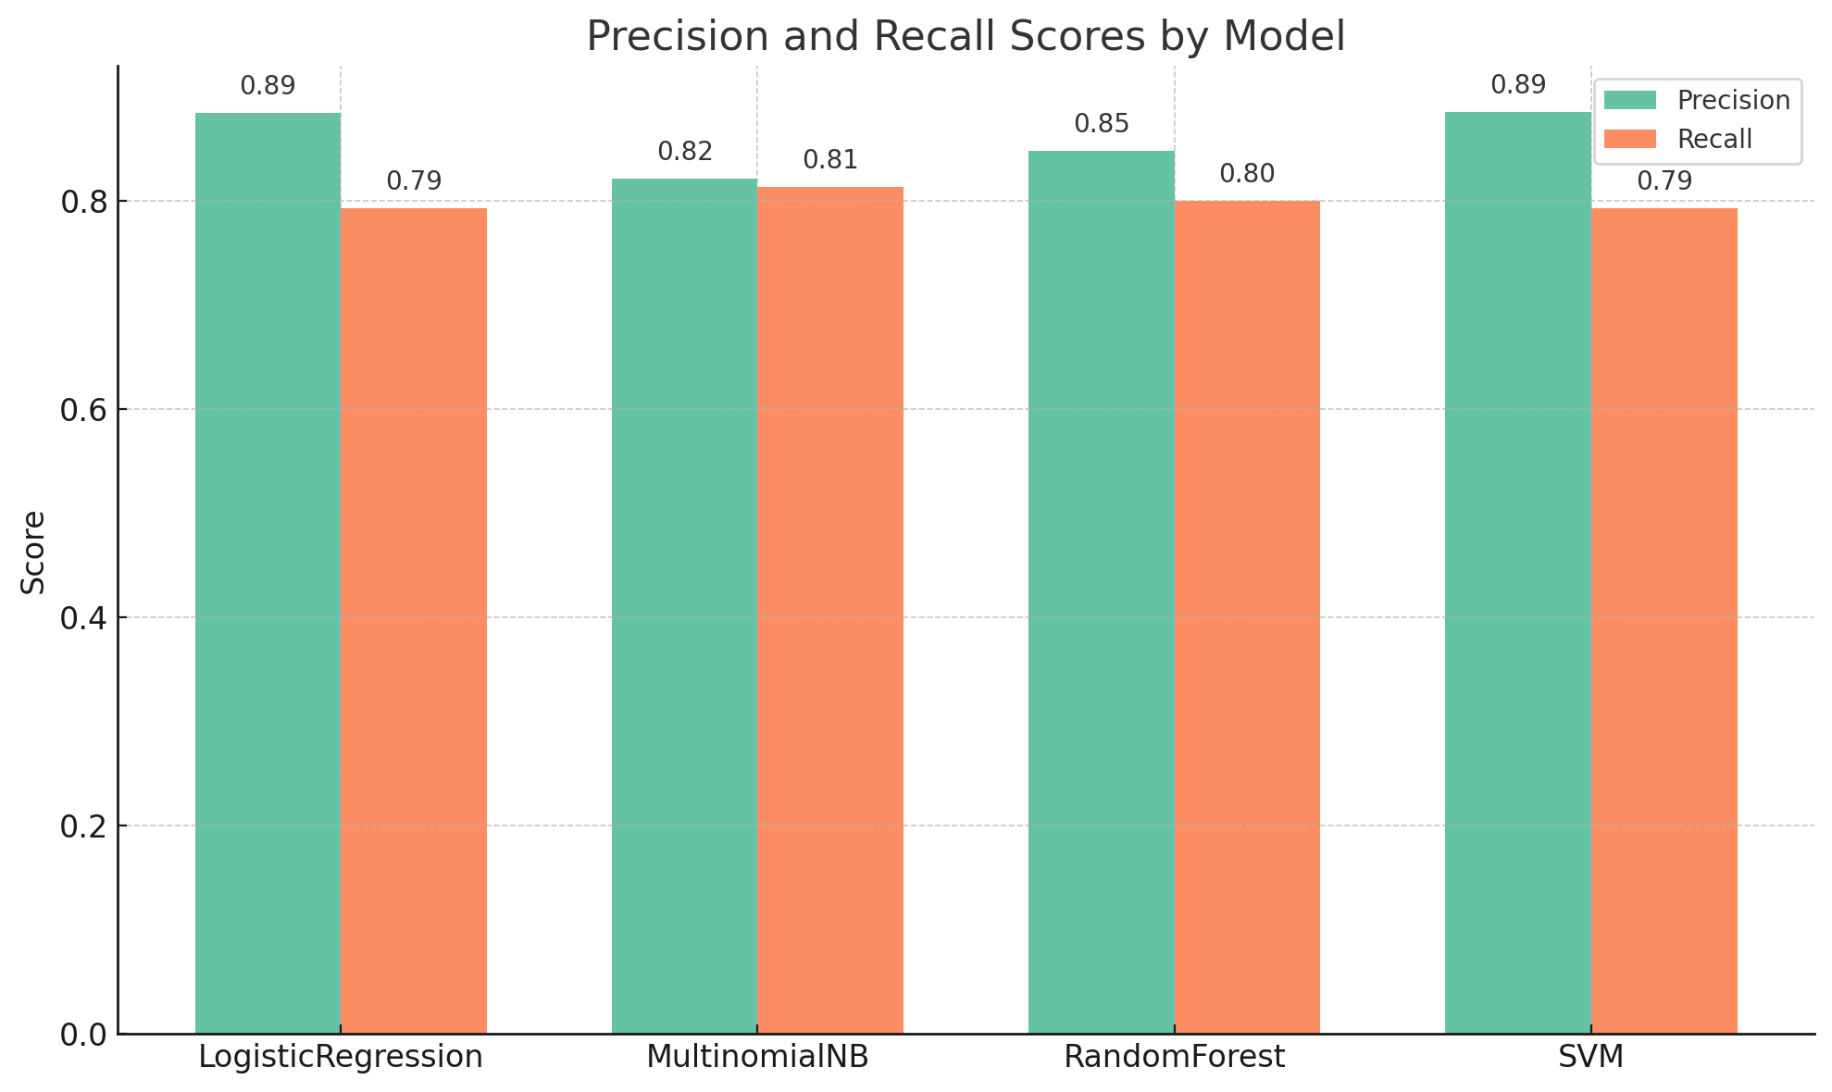
Model Performance (TF-IDF Features)
01
Multinomial Naive Bayes
02
Logistic Regression
03
Random Forest Classifier
04
Support Vector Machine

Slide 9
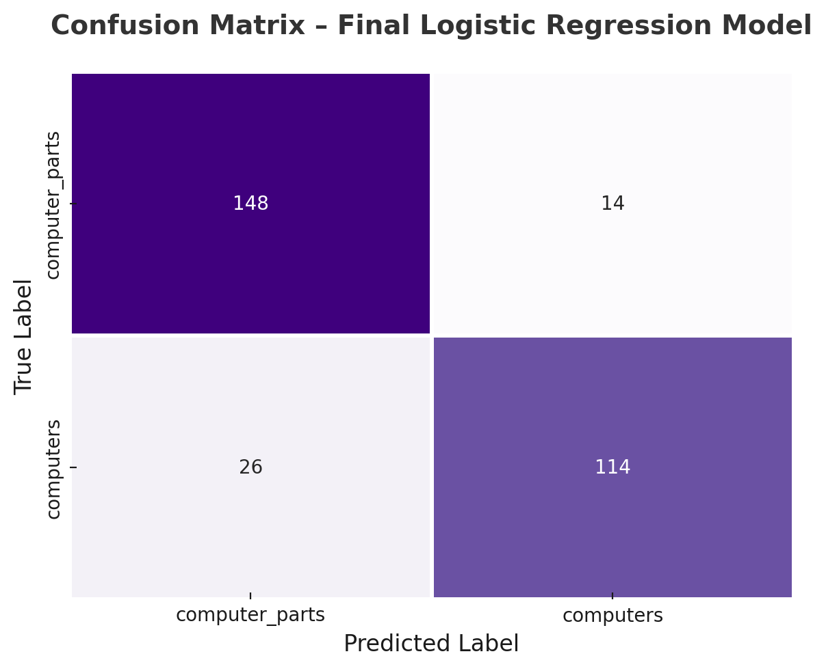
Model Evaluation
The Logistic Regression model achieved an overall accuracy of 85.4% on the test set.
It delivered a balanced performance with 88.5% precision and 79.3% recall, resulting in an F1 score of 83.4%.
Logistic Regression was chosen as the final model due to its strong consistency, interpretability, and efficient deployment potential.
Notes:
不知道

Slide 10



VALUE TO CRAIGSLIST
Better Search Experience
Enhanced user experience through faster, more relevant search results.
Efficient Moderation
Reduced moderation burden, allowing teams to focus on edge cases.
Scalable Across Categories
Scalable solution applicable to other major sections like Jobs, Cars, and Housing.

Slide 11

Thank You!
Questions?
We’d love to hear your thoughts
Presented by Group 9

